Slide 1

Campus Recruitment Academic and Employability Factors Influencing Placement
Felicia p

Slide 2
DATA UNDERSTANDING
Campus Recruitment
Academic and Employability Factors Influencing Placement
ssc_p = 10th Grade percentage
ssc_b = 10th Grade board
hsc_p = 12th Grade percentage
hsc_b = 12th Grade board
hsc_s = Higher secondary stream
degree_p = Undergraduate percentage
degree_t = Undergraduate degree type
workex = Work experience
etest_p = Placement test percentage
Specialisation = MBA specialisation
Mba_p = MBA percentage
Status = Hiring status

Slide 3
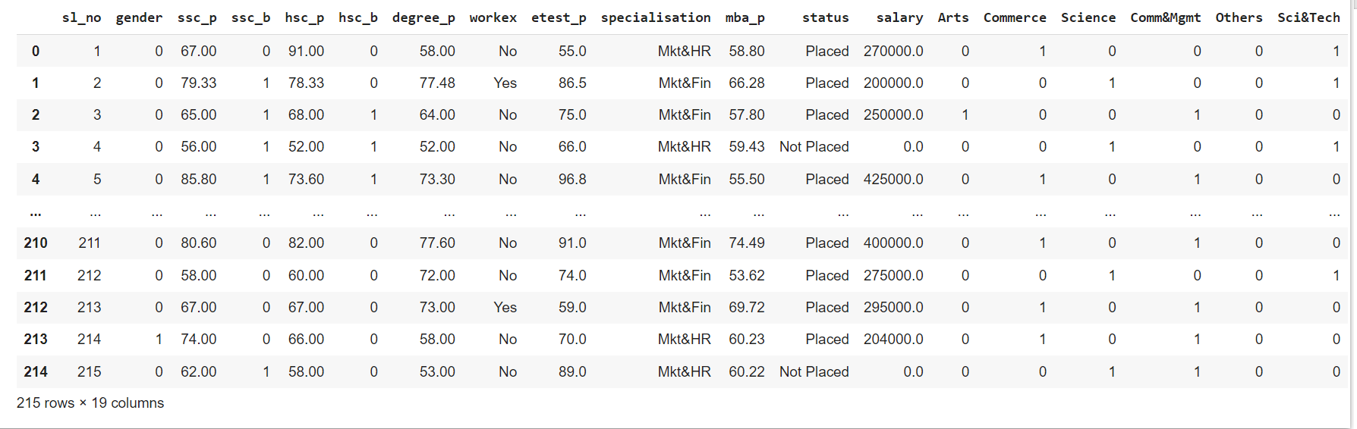
DATA OVERVIEW

Slide 4
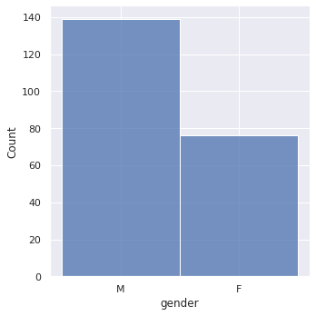
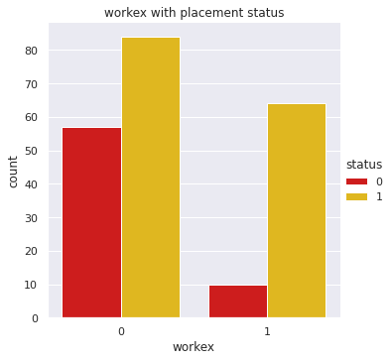
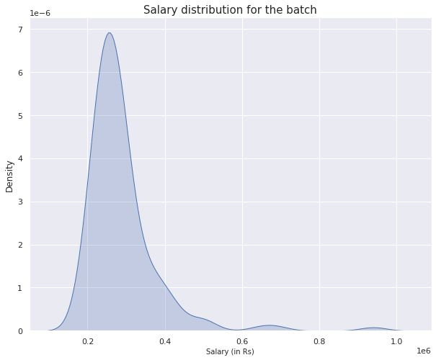
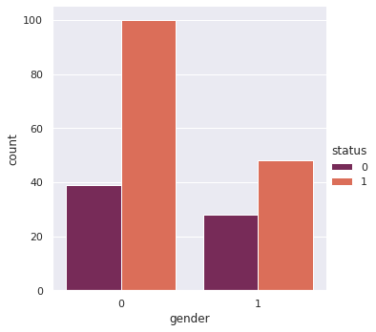
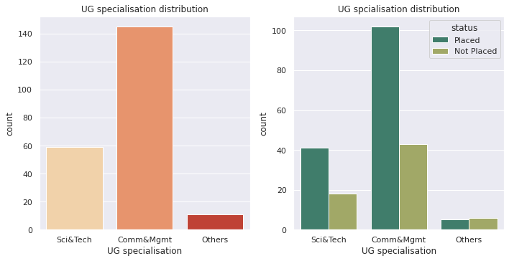
DATA VISUALIZATION

Slide 5
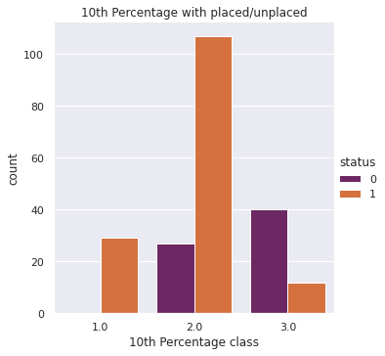
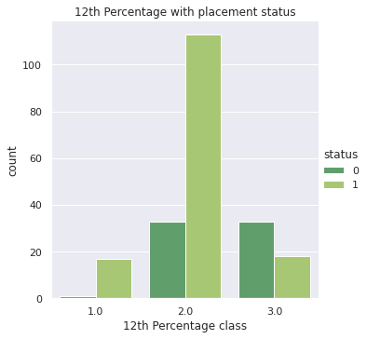
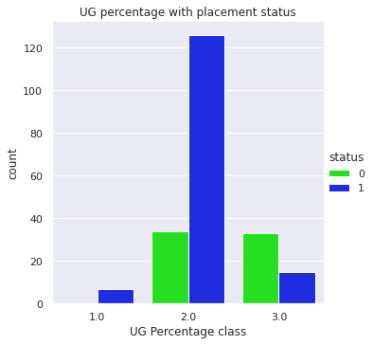
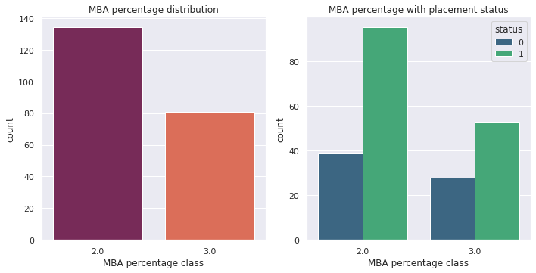
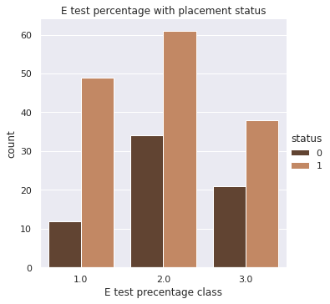

Slide 6
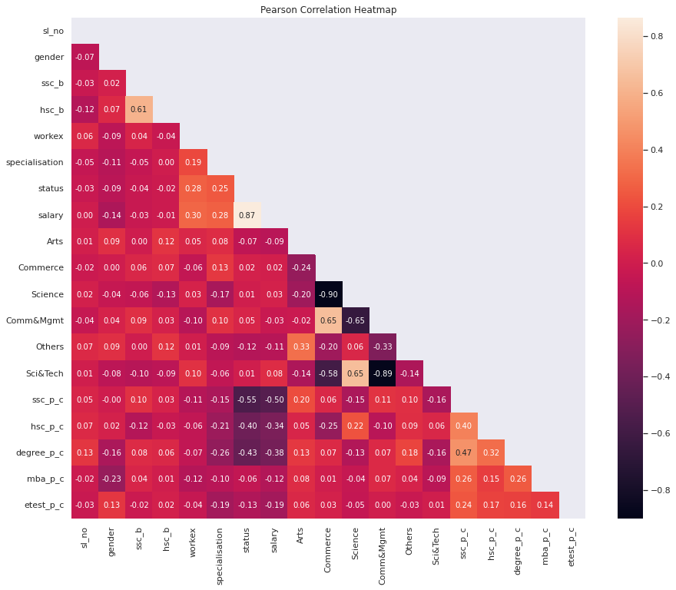
Correlation Between Columns
The features are not highly correlated each other.
Target variable = ‘Status’

Slide 7
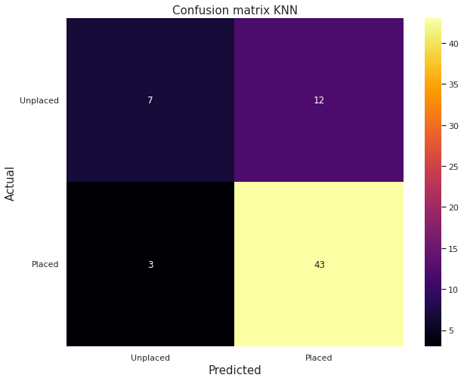
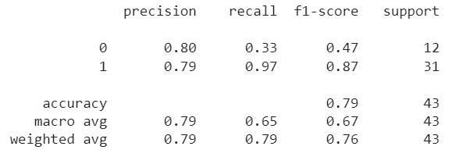
KNN Test Accuracy

Slide 8
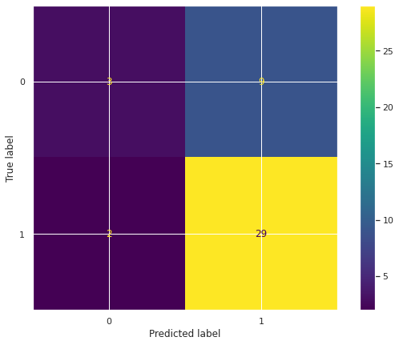
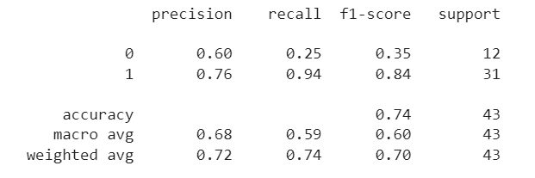
Random Forest Test Accuracy

Slide 9
Thank You

